Slide 1



DevOps for Data Science (DataOps)
With Azure DevOps, Docker and Kubernetes
Terry McCann | @SQLShark

Slide 2
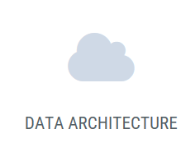
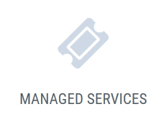

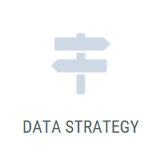
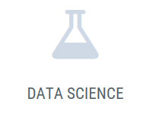
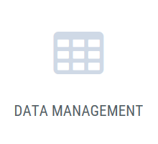
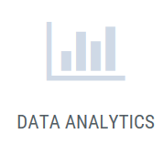
We enable our clients make sense of their data

Slide 3


Where to find the slides and demos
https://github.com/SQLShark
Terry McCann 2018
Notes:
• How to Use the WHERE Clause
• Overview of Operators
• Filter Data by Using Comparison Operators
• Filter Data by Using String Comparisons
• Filter Data by Using Logical Operators
• Filter Data Using a Range of Values
• Filter Data Using a List of Values
• Working with NULL Values
• Introducing Native SQL Server Functions
• Functions Relating to NULL Values

Slide 4


Questions?
Shout them out!!

Slide 5
Who is a Data Scientist?

Slide 6
Who is a Software developer?

Slide 7
In this session we will look to understand what a Data scientist does well and what they do badly
We will explore the history of DevOps. We will look at the core components and how they relate to machine learning.
We will learn then look at how we can hook this all together with a demo of Azure DevOps, Python, Docker and Kubernetes

Slide 8
“Productionisation of models is the TOUGHEST problem in data science”
Schutt, R & O'Neill C, 2014. Doing Data Science Straight From the Front Line, O'Reilly Press. California
Notes:
Meet a great bunch of people
You’re a point of authority
You get to shout at people
You get in for free (save a bit of money)
Free drinks

Slide 9
But why?
Notes:
Meet a great bunch of people
You’re a point of authority
You get to shout at people
You get in for free (save a bit of money)
Free drinks

Slide 10




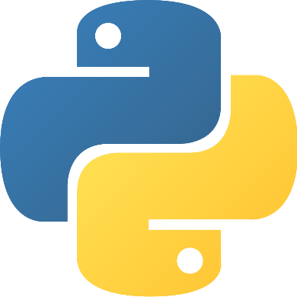


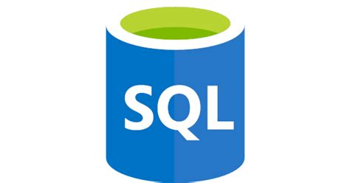
But why?
Notes:
Meet a great bunch of people
You’re a point of authority
You get to shout at people
You get in for free (save a bit of money)
Free drinks

Slide 11
Data Scientist
Highly Academic
Statistically minded
Particularly strong in ML languages
Not from a software background
Thinks testing is hard
Doesn’t use source control
Thinks deployments are the responsibility of another team

Slide 12
Models are not in production
Notes:
Meet a great bunch of people
You’re a point of authority
You get to shout at people
You get in for free (save a bit of money)
Free drinks

Slide 13
How do we fix this problem?
Notes:
Meet a great bunch of people
You’re a point of authority
You get to shout at people
You get in for free (save a bit of money)
Free drinks

Slide 14
Developer
I write code in Python
I write new features
I fix old code & Bugs
I wait weeks to deploy my code
Time to market for my products is suffering
My customers are not happy!
Operations are too slow!

Slide 15
Operations
I manage Production code in Java
Our environments != the same
I am responsible for 99.9% uptime
I manage hundreds of servers
Our company is growing fast and so is my responsibilty
I own the bugs from deployments
Developers don’t care about uptime!

Slide 16

Developer
Operations
CODE

Slide 17
Dev
Ops

Slide 18
1. Culture
2. Source Control
3. Continuous integration/testing
4. Continuous deployment
5. Infrastructure as code
Dev
Ops
6. Configuration as code
7. Automation
8. Operational Monitoring / Feedback

Slide 19
Lets automate the deployment of data science with DevOps
Notes:
Meet a great bunch of people
You’re a point of authority
You get to shout at people
You get in for free (save a bit of money)
Free drinks

Slide 20
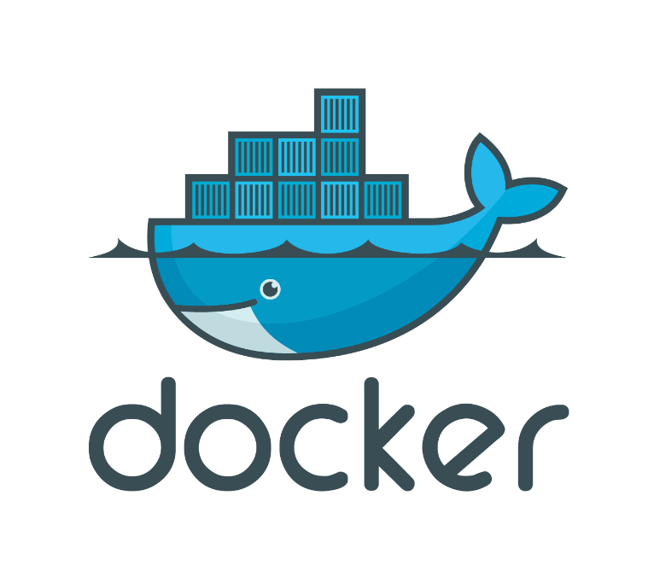


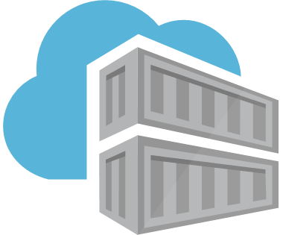

https://modelmanagement.visualstudio.com/DundeeDataScience/
Demo
Notes:
Meet a great bunch of people
You’re a point of authority
You get to shout at people
You get in for free (save a bit of money)
Free drinks

Slide 21
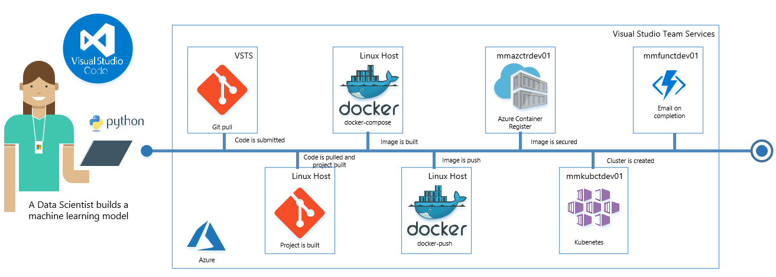
Automate with DevOps
Notes:
Meet a great bunch of people
You’re a point of authority
You get to shout at people
You get in for free (save a bit of money)
Free drinks

Slide 22
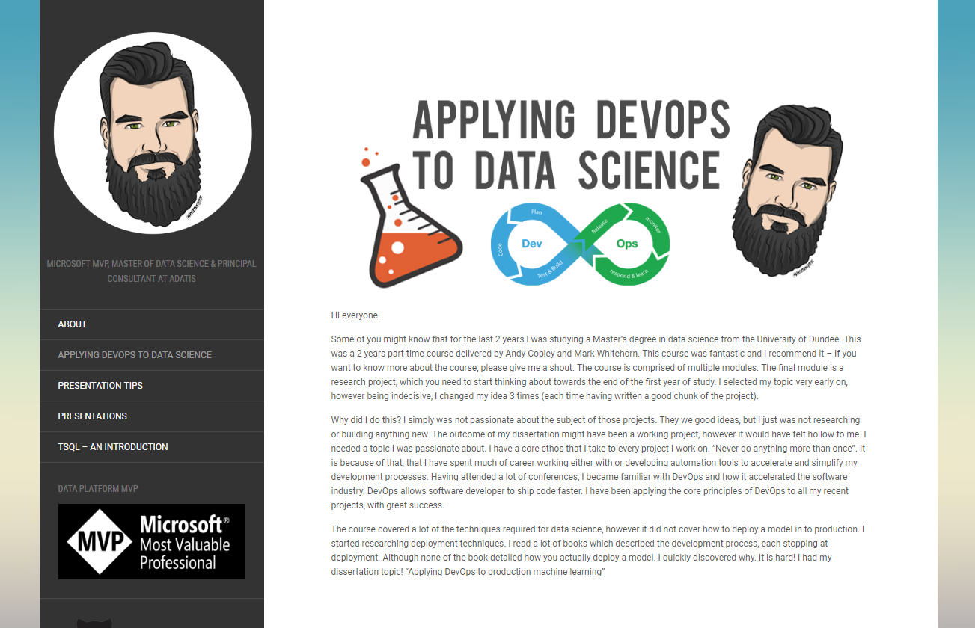
http://www.hyperbi.co.uk/applying-devops-to-data-science/
Notes:
Meet a great bunch of people
You’re a point of authority
You get to shout at people
You get in for free (save a bit of money)
Free drinks

Slide 23
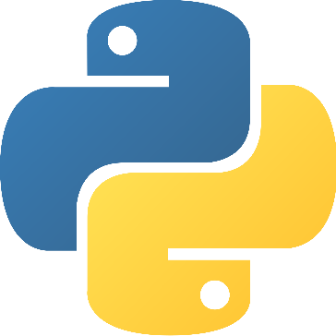
DevOps will make your life easier!
Start learning how to get your models in to production. Automate that which is difficult.
Reduce your time to production, control and test your code. Monitor and manage your models in production.
@SQLShark
tpm@adatis.co.uk
www.adatis.co.uk
@AdatisBI

